Slide 1
CASE STUDY: AI-POWERED SUPPLY CHAIN ANALYTICS

Slide 2
Business Context & Problem
Atlart expanded from India to the USA (New Jersey) with strong demand but faced:
Customer dissatisfaction
Inconsistent order fulfillment
Poor visibility into service performance
Root Cause
Immature supply chain processes
Manual, slow reporting (Excel / BI)
No single source of truth across geographies
Leadership Question
“Should we scale further, or fix operations first?”

Slide 3
Solution Overview (AI-First Architecture)
End-to-End Analytics Solution
Architecture Email → n8n → PostgreSQL (Supabase) → Quadratic (AI Spreadsheet)
Capabilities
Automated daily ingestion of sales data
Centralized, analytics-ready data model
Prompt-driven KPI generation and analysis
Why AI
Faster insights
Reduced manual effort
Flexible, ad-hoc business questioning

Slide 4
Automated Data Ingestion with n8n
Monitors a Gmail inbox for incoming sales emails using a trigger-based workflow
Validates incoming attachments to ensure only CSV files are processed
Generates a unique hash for each file to prevent duplicate ingestion
Checks file hash against PostgreSQL to detect already processed files
Filters out duplicate files using conditional branching logic
Stores new file hashes in the database for idempotent processing
Merges and cleans incoming JSON data for consistent downstream handling
Uses rule-based switching to route aggregate vs line-level datasets
Extracts order aggregate & order line CSV attachments (India & USA)
Convert CSV → JSON
Load data into PostgreSQL tables
Support incremental daily loads

Slide 5
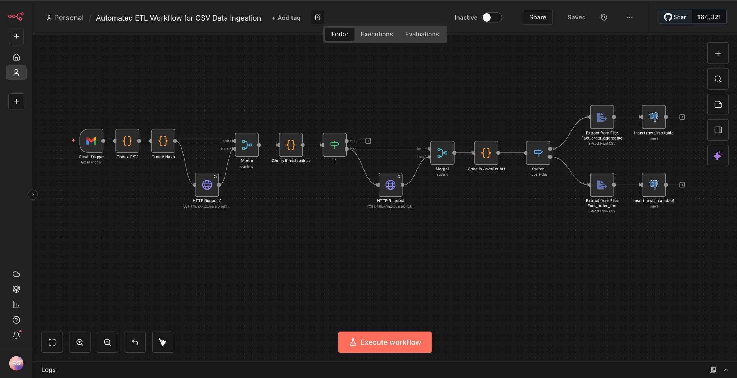

Slide 6
Data Model
Fact Tables
fact_orders_aggregate – Order-level data
fact_order_line – Item-level order details
Dimension Tables
dim_customers
dim_products
dim_targets_orders
dim_date (AI-generated)
Derived Tables
exchange_rates
fact_summary (denormalized analytics table)
processed_files - tracks ingested file hashes to ensure idempotent ETL and prevent duplicate data loads

Slide 7
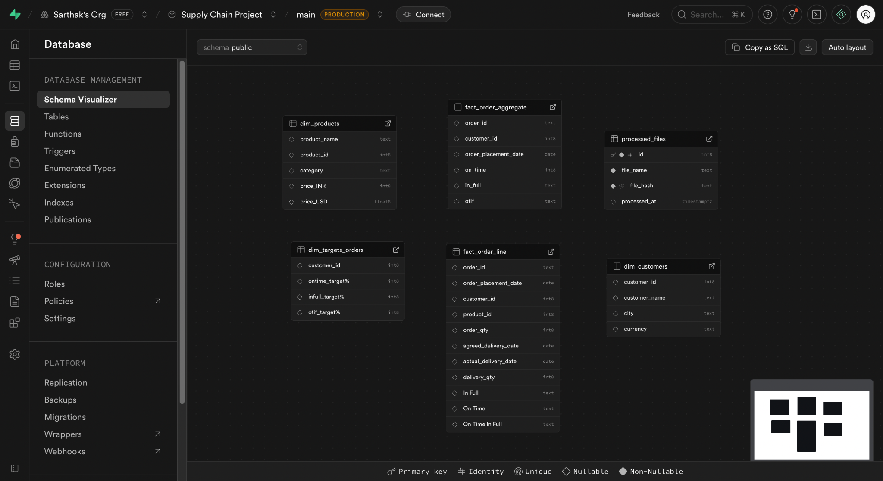

Slide 8
Key Supply Chain KPIs
Performance Metrics Tracked
Total Orders & Order Lines
Line Fill Rate
Volume Fill Rate
On-Time Delivery %
In-Full Delivery %
OTIF (On-Time In-Full)
Customer Reliability Metrics

Slide 9
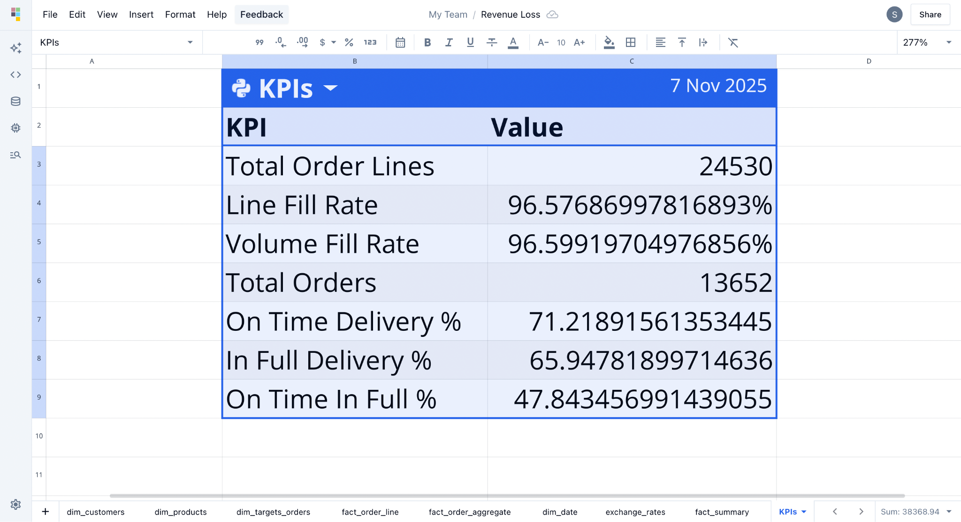
Business Insights and Recommendations
Findings:
Overall OTIF is ~48%, which is critically low for an FMCG supply chain
Over 34% of orders experience shortages
Late delivery rate is ~29%
Recommendation: Pause expansion into new cities or countries. Scaling with current service levels will amplify customer dissatisfaction and revenue leakage.

Slide 10
Business Insights and Recommendations
Findings:
Line Fill Rate & Volume Fill Rate are high (~96%)
In-Full Delivery % is low (~66%)
OTIF failure is driven more by quantity shortfalls than delays
Insight:
Possibly due to inventory management, demand forecasting, or last-mile delivery issues rather than major supply disruptions.
Recommendation: Rebalance inventory policies:
Improve safety stock for high-volume SKUs
Align replenishment planning with order patterns
Impact: Improving In-Full directly lifts OTIF without major logistics costs.

Slide 11
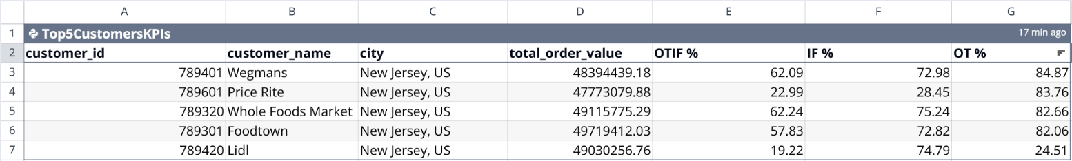
Business Insights and Recommendations
Findings:
US customers show higher order value
Performance Variance: There's significant variation in On-Time In Full (OTIF) delivery:
Best performers: Whole Foods Market (62.24%) and Wegmans (62.09%)
Worst performers: Lidl (19.22%) and Price Rite (22.99%)
In Full Delivery: All customers maintain decent IF rates (72-75%), except Price Rite at 28.45%
On Time Delivery: Most customers have strong OT rates (82-85%), with Lidl lagging at 24.51%
Recommendations:
Lidl and Price Rite need immediate attention for improving both on-time and in-full delivery metrics
Scale within New Jersey (same region, same network) rather than entering new geographies.

Slide 12
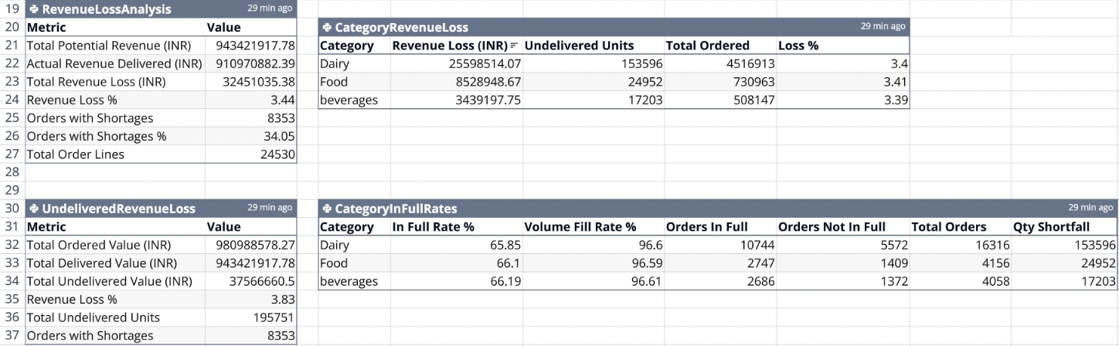
Business Insights and Recommendations
Insights:
Dairy products account for 68% of the total revenue loss (₹25.6M out of ₹37.6M), making it the priority category for improving fulfillment rates.
Dairy is the most impacted category:
5,572 orders not fulfilled completely (67% of all incomplete orders)
153,596 units short (78% of total shortfall)
This aligns with the earlier revenue loss analysis showing Dairy accounts for 68% of revenue loss

Slide 13
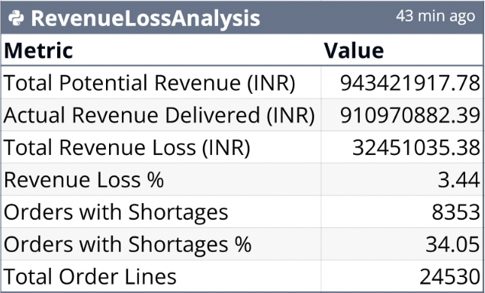
Revenue Impact: What can realistically be saved?
Current state:
Revenue Loss ≈ ₹3.2-3.4 Cr (~3.4%)
Orders with shortages: ~8,300
Conservative improvement scenario:
Improve OTIF from 48% to 65%.
Reduce shortages by ~40 to 50%
Estimated annual revenue saved:
₹1.3-1.7 Cr can be recovered
Plus indirect gains:
Higher customer retention
Better negotiation leverage

Slide 14
THANK YOU!

